Slide 1
Google BigQuery
Workshop Group-03

Slide 2



Team Members:
Samanth Gourineni
Deepak Sai Krishna Jayanthi
Rohith Bharadwaj

Slide 3
Contents:
What is BigQuery?
Features of BigQuery
More about BigQuery
Why BigQuery used for?
BigQuery architecture
Comparisons
Demo
Conclusion
Deepak Jayanthi

Slide 4
What is BigQuery?
BigQuery is a cloud based interactive query service for massive datasets.
This is a serverless, scalable data warehousing cloud product offering by Google cloud platform(GCP)
It is a serverless software as a service(SaaS), that may be used complementarily with MapReduce.
Deepak Jayanthi

Slide 5
Features:
Managing data: You can create and delete tables based on a JSON-encoded schema and import the data encoded as CSV or JSON from Google Storage.
Query: The queries are expressed in standard SQL dialect, and the results are returned in JSON format. The maximum reply length of the result will be of unlimited size, when large query results are enabled.
Access control: It is possible to share datasets with arbitrary individuals, groups, or the world.
Deepak Jayanthi

Slide 6
More about BigQuery
You can do loading and exporting of the data into BigQuery storage.
You can run interactive and batch queries.
Listing projects, jobs, datasets and tables.
Getting information about jobs, datasets and tables.
Defining, updating or patching datasets and tables.
Deleting datasets and tables.
Managing table partitions.
Deepak Jayanthi

Slide 7
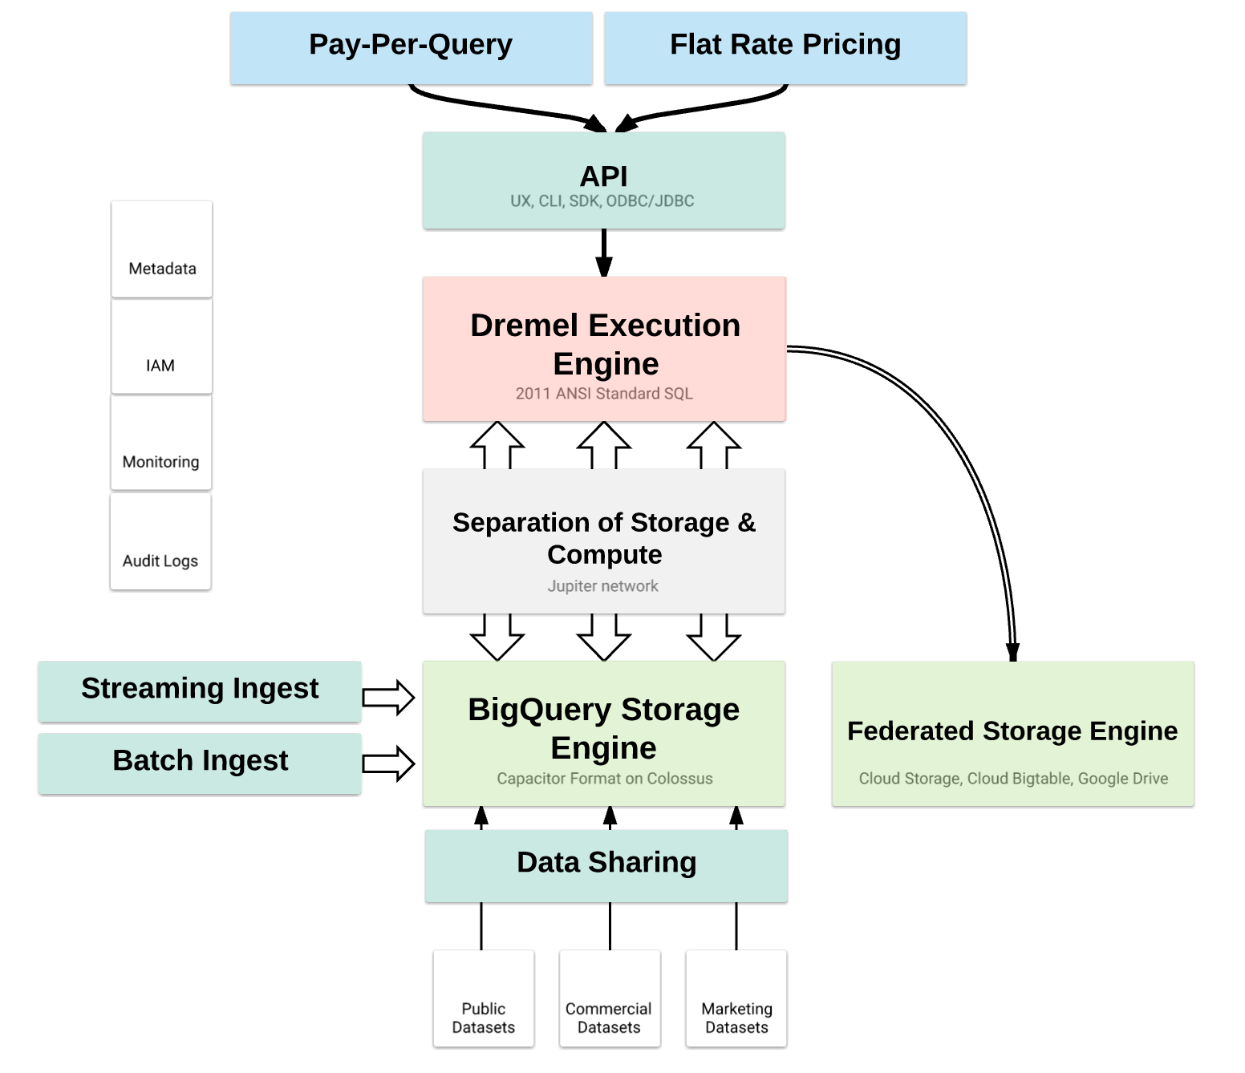
Architecture:
Dremel
Colossus
Jupiter Network
Data Model/Storage:
Columnar storage.
Nested/Repeated fields.
No Index: Single full table scan.
Rohith Bharadwaj
Notes:
The big query is based on Dremel Technology. Dremel is a tool used in Google for about 10 years.

Slide 8
Google BigQuery Comparison with MapReduce and NoSQL:
MapReduce | BigQuery
High Latency. Flexible (complex) batch processing. Unstructured Data. | Low Latency. SQL-like Queries. Structured Data.
Rohith Bharadwaj

Slide 9
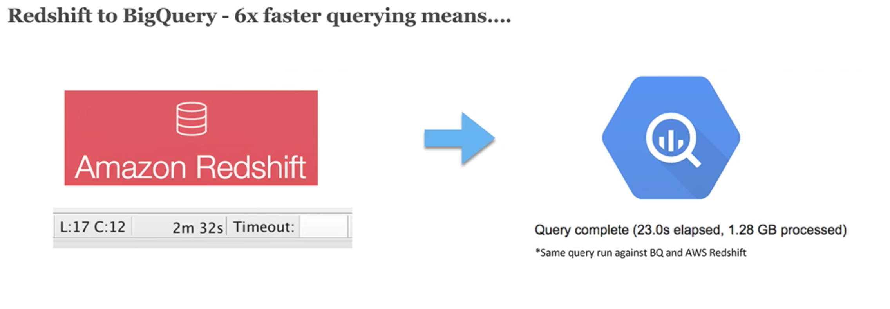
NoSQL Data store vs. BigQuery
NoSQL Data store | Big Query
Index based. | Non-index based.
Read-write. | Read-only.
Rohith Bharadwaj

Slide 10
Demo
Samanth Gourineni

Slide 11
Conclusion
BigQuery is helpful when we run the heavy queries for very large datasets.
It helps in running complex analytical queries.
BigQuery is good for scenarios where data does not change often and you want to use cache, as it has built-in cache.
Samanth Gourineni

Slide 12
References:
https://www.slideshare.net/matthiasfeys/introduction-to-bigquery
https://www.youtube.com/watch?v=qqbYrQGSibQ
https://cloud.google.com/bigquery/docs
https://www.toptal.com/database/google-bigquery-tutorial
Samanth Gourineni

Slide 13
Any Questions?
Samanth Gourineni

Slide 14
Thank You
Samanth Gourineni

